Slide 1
Model/Variable Selection
Discrete:
Best Subset
Forward
BIC
CP
Adj.R2
Continuous:
LASSO
Ridge

Slide 2
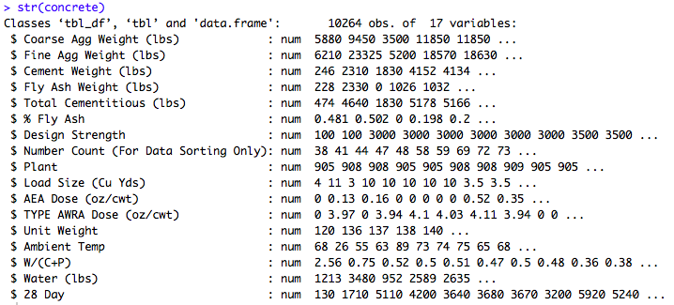
Potential Predictors

Slide 3
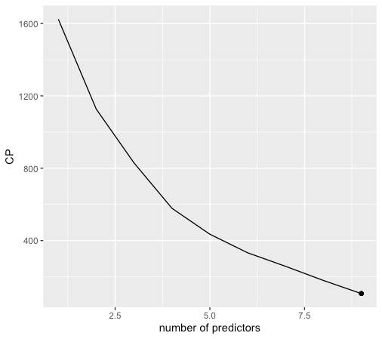
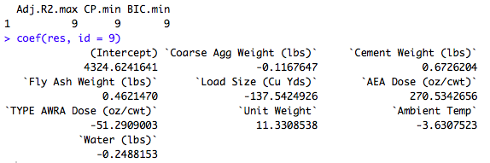
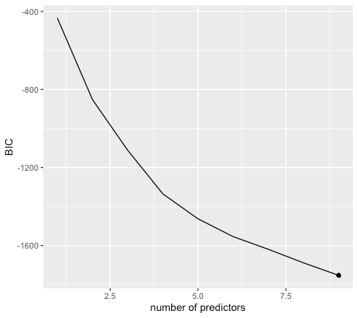
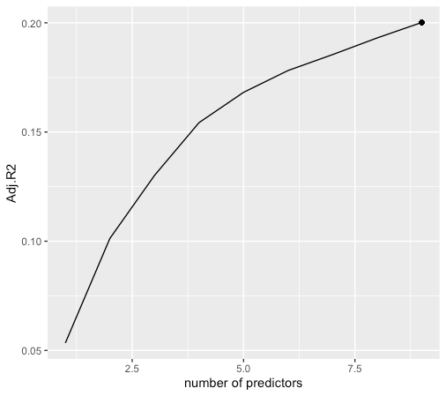
Bes
Best Subset

Slide 4
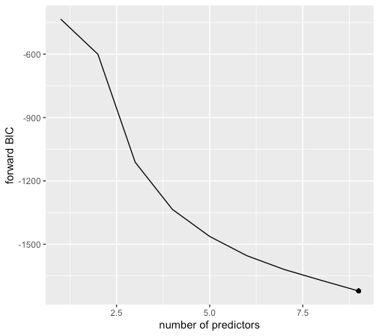
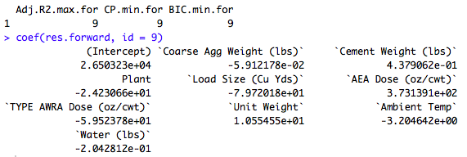

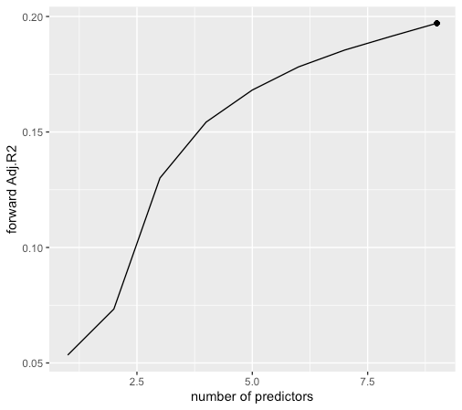
Forward Selection

Slide 5
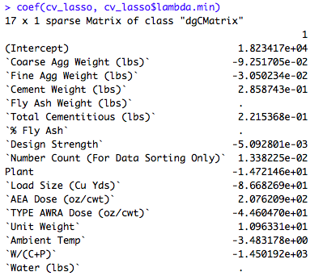
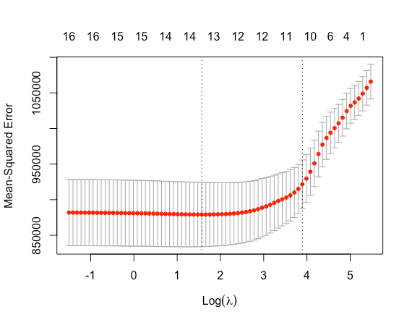
LASSO

Slide 6
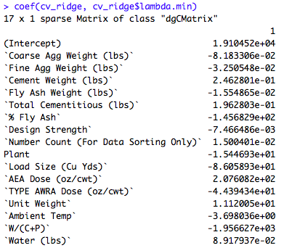
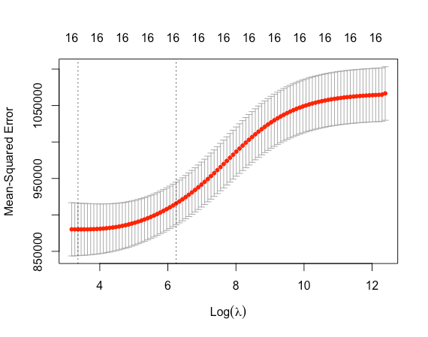
Ridge

Slide 7
Previously…Potential Predictors

Slide 8
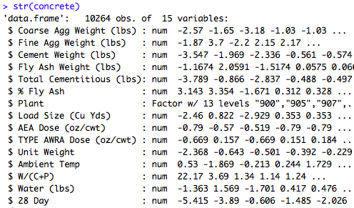
Potential Predictors

Slide 9
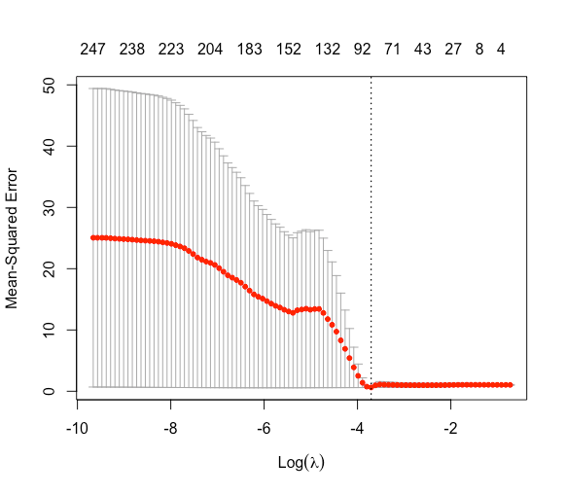
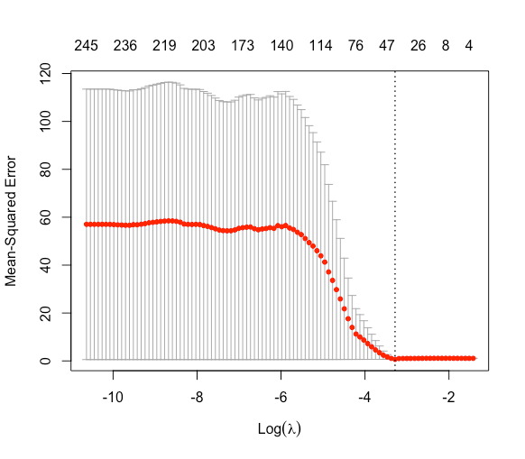
 | R^2 | MAPE | MSE
LASSO | 0.26 | 0.12 | 6.2
Ridge | 0.26 | 0.12 | 6.2
Best | 0.21 | 0.15 | 7.8
Forward | 0.17 | 0.15 | 7.7
Elastic Net
 | Rsquare |  | MAPE | MSE | lambda_min
 | training | testing
LASSO | 0.37 | 0.36 | 0.11 | 5.9 | 0.037
Elastic Net | 0.44 | 0.4 | 0.1 | 5.7 | 0.025
Random Forest | 0.58 | 0.59 | 0.09 | 4.4 | /
LASSO
Notes:
Use Lasso to select important features and then use random forest.

Slide 10
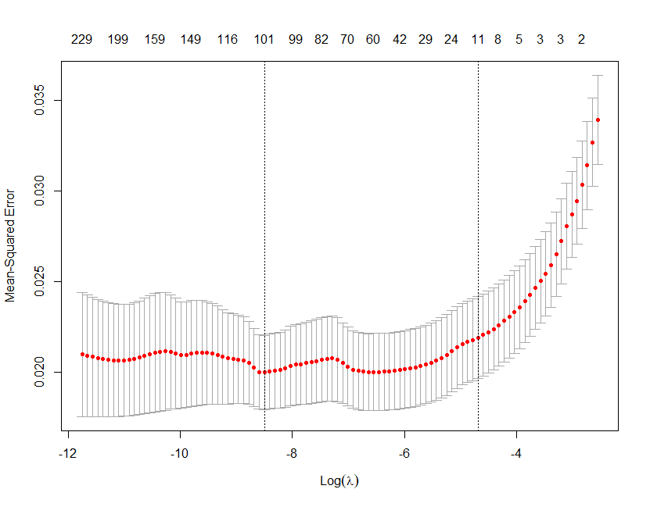
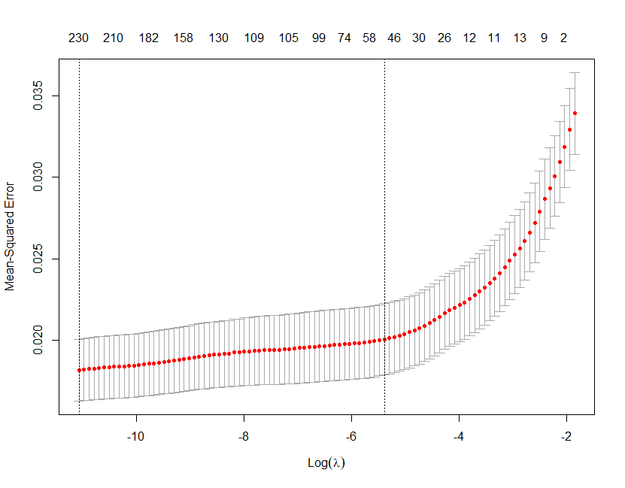
LASSO
Elastic Net
If we chose lambda, which gives the minimum MSE:
If we choose lambda that balance the complexity and the MSE:
 | R^2 | MAPE | MSE
LASSO | 0.51 | 0.099 | 5.07
Elastic Net | 0.52 | 0.098 | 5.04
 | R^2 | MAPE | MSE
LASSO | 0.42 | 0.105 | 5.5
Elastic Net | 0.44 | 0.103 | 5.4

Slide 11
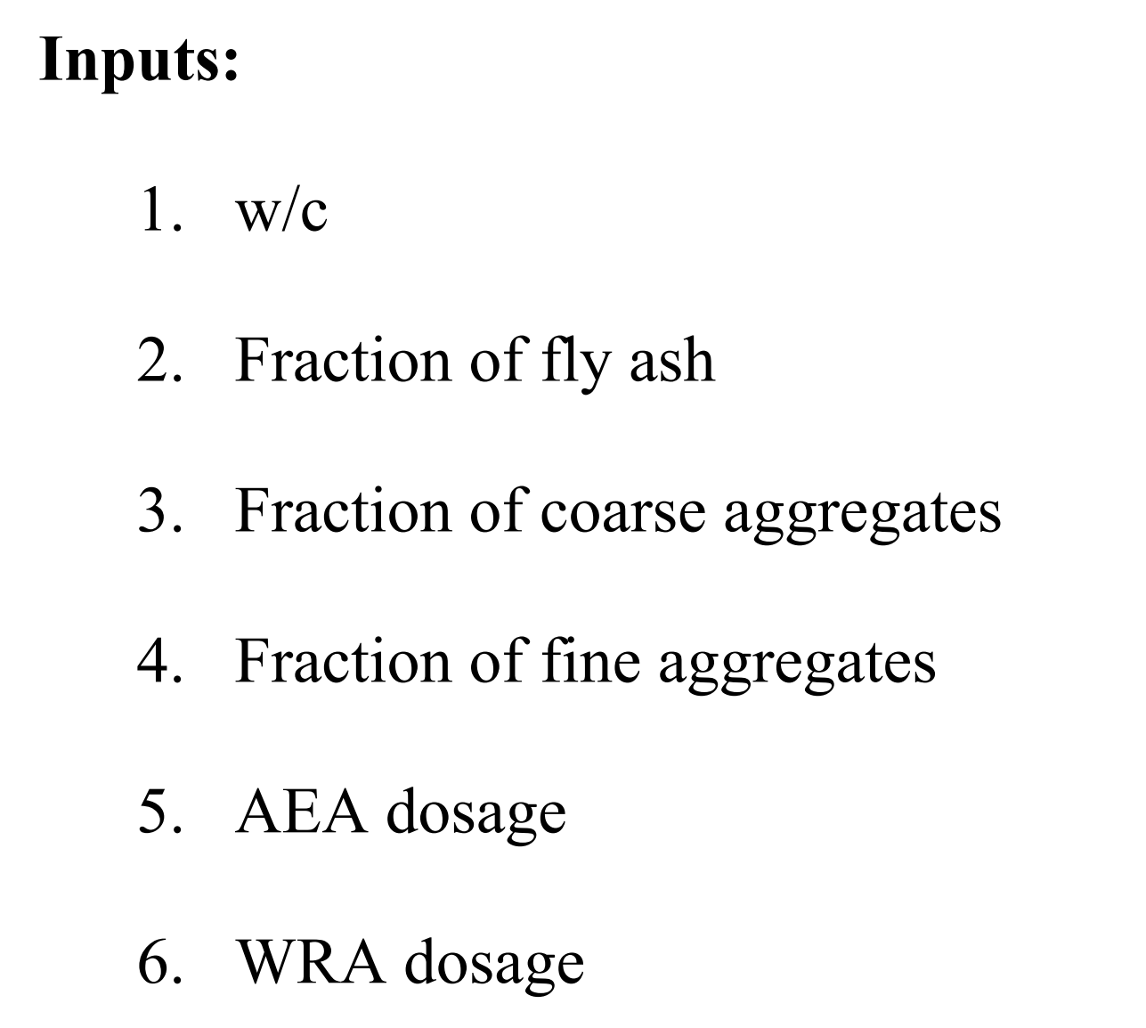
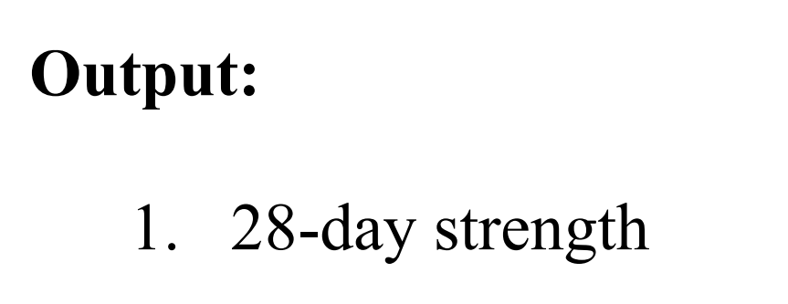
Clean Data

Slide 12
Clean Data
 | Degree | R^2 | MAPE | MSE | # of predictors
LASSO | 2 | 0.54 | 0.095 | 4.84 | 17
 | 3 | 0.56 | 0.092 | 4.72 | 35
Elastic Net | 2 | 0.55 | 0.094 | 4.8 | 19
 | 3 | 0.57 | 0.092 | 4.68 | 35
random forest | 1 | 0.63 | 0.085 | 4.35 | 6

Slide 13
Extrapolation (clean data)
Low 50%
High 50%
Concrete strength

Slide 14
 | Random Split |  |  | Extrapolation
 | R Squared | MAPE | RMSE | R Squared | MAPE | RMSE
LS | 0.58 | 0.09 | 4.66 | -47.69 | 0.21 | 38.8
Lasso | 0.57 | 0.09 | 4.67 | -2.92 | 0.28 | 11.35
Elastic Net | 0.57 | 0.09 | 4.67 | -2.93 | 0.28 | 11.36
RF | 0.61 | 0.087 | 4.47 | -2.97 | 0.28 | 11.43
ANN | ? | ? | ? | -0.58 | 0.18 | 8.42

Slide 15
Extrapolation (28 Day clean data) continued
Previously
Low 50%
High 50%
Linear Regression
Random Forest
Ordered
Concrete strength
Now
Low 80%
High 20%
Shuffled Low
Neural Network

Slide 16
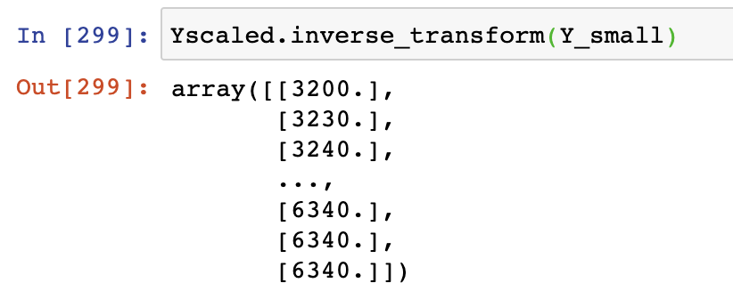
Univariate Distribution of Y

Slide 17
r2_score | 0.64
RMSE | 4.28
r2_score | 0.6
RMSE | 4.51
Random
Split
r2_score | 0.37
RMSE | 3.28
r2_score | -2.44
RMSE | 10.14
Extrapo-
lation

